Slide 1


AI Employees,
Not AI Tools
Pre-Seed 2026
Persistent agents that accumulate expertise and deliver compounding work products.
yarnnn.com · Kevin Kim · kvkthecreator@gmail.com

Slide 2
The industry is bifurcating.
The AI agent wave is here. OpenClaw: 307K GitHub stars in 60 days. Claude shipped Cowork. Cursor has a million daily users. Massive demand for AI that does real work.
But every product in this wave is a tool. Session-scoped. User-present. Stateless between runs. Recurring knowledge work requires something structurally different.
But every platform cycle looks that way — until it doesn't.
Google didn't become Salesforce.
Facebook didn't become Shopify.
AWS didn't become Datadog.

Slide 3
The Landscape
Three approaches to AI agents. Only one builds employees.
OpenClaw
|
307K stars. Open-source. Session-scoped — resets every time. No scheduling, no memory.
Claude Cowork
|
Anthropic desktop agent. Powerful in-session. No persistence, no autonomy.
yarnnn
|
Cloud-native AI employees. Persistent. Autonomous. Cross-platform. Accumulates — never resets.
The difference
|
Tools reset every session. Employees accumulate over months. The gap is structural.
OpenClaw and Cowork validate massive demand for AI that does real work. But tools reset. yarnnn is the only product where that work compounds.

Slide 4
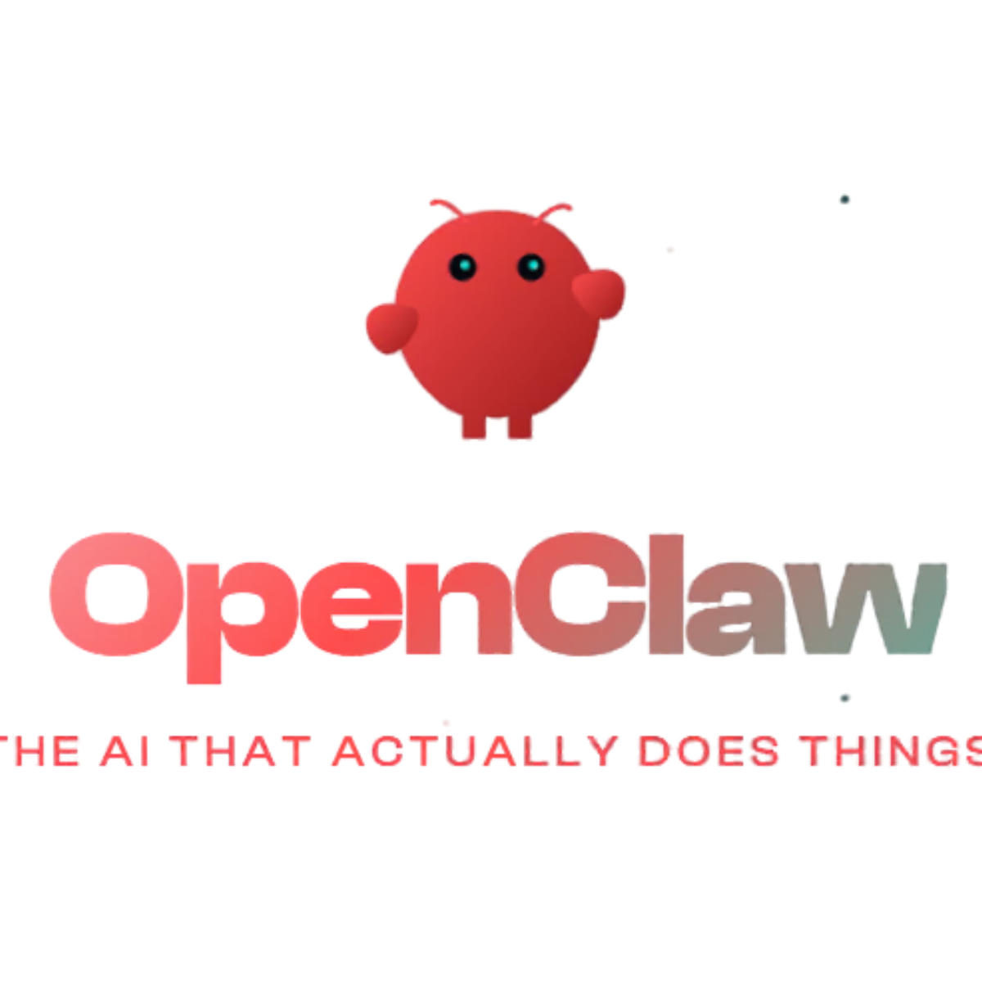
The Product
What your AI employees do that tools can’t.
1 Work autonomously
Run on schedule — nights, weekends, holidays. Recurring deliverables arrive on time, every time.
2 Accumulate expertise
Every run deepens domain knowledge. Every edit teaches preferences. 90 days of tenure is irreplaceable.
3 Perceive across platforms
Slack, Notion, GitHub syncing continuously. Cross-platform awareness no single tool has.
4 Coordinate as a team
10-agent roster + task pipeline. Autonomous execution, not solo prompting.
5 Deliver real work product
Weekly briefs, research reports, competitive intel. Not chat responses — formatted deliverables.
This is the employee layer. Not a better chatbot — a new category of autonomous knowledge worker.

Slide 5
Product
Architecture
Solution / Moat

Slide 6
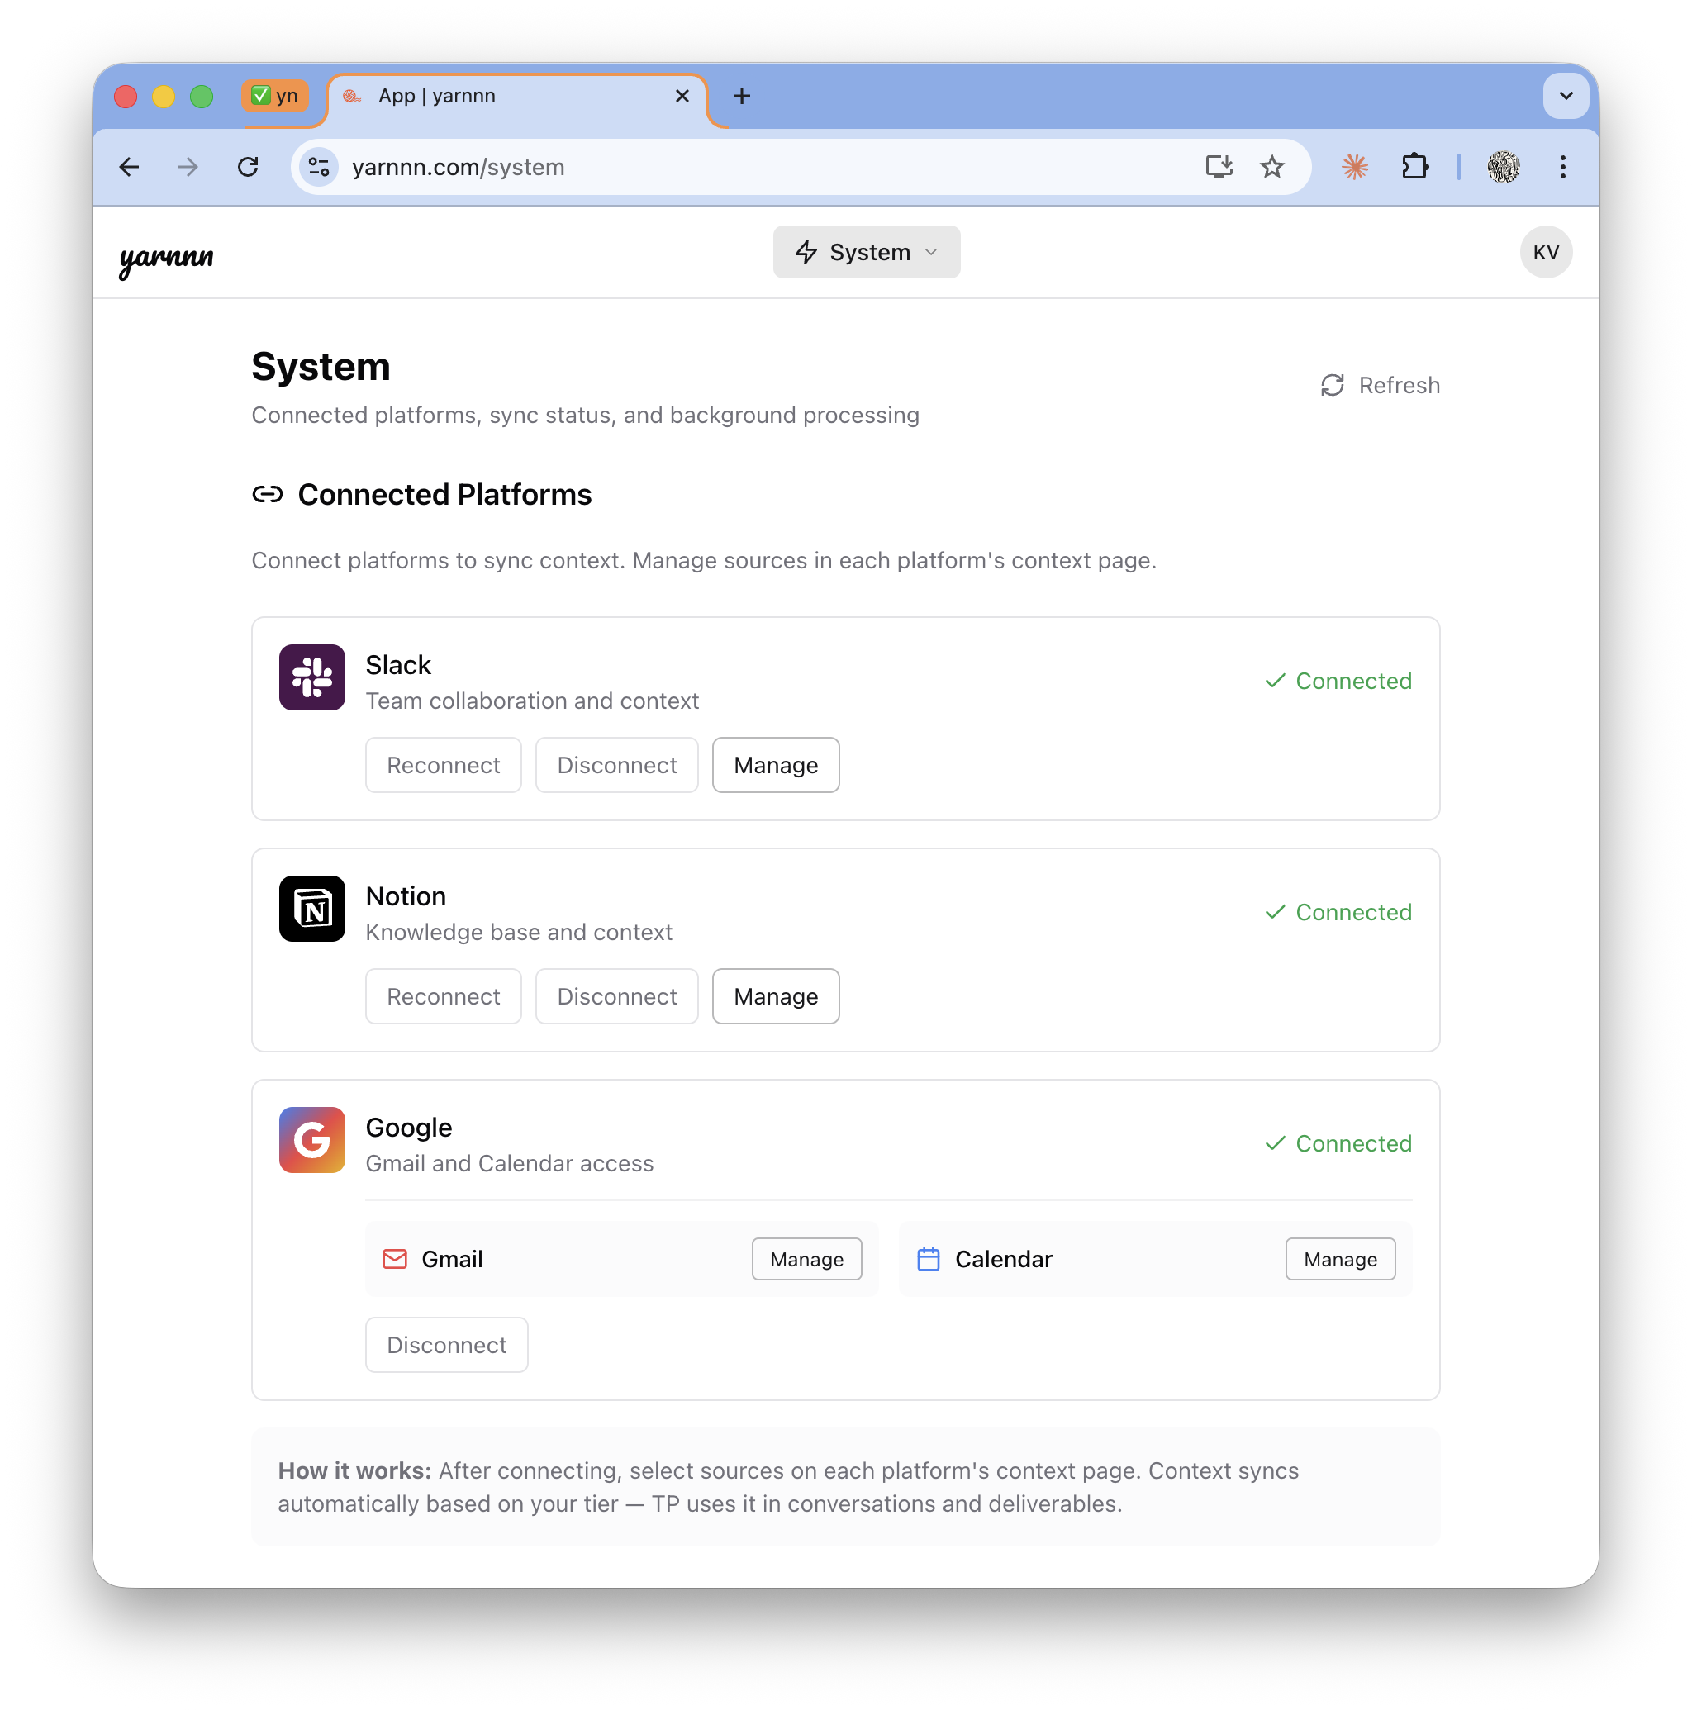
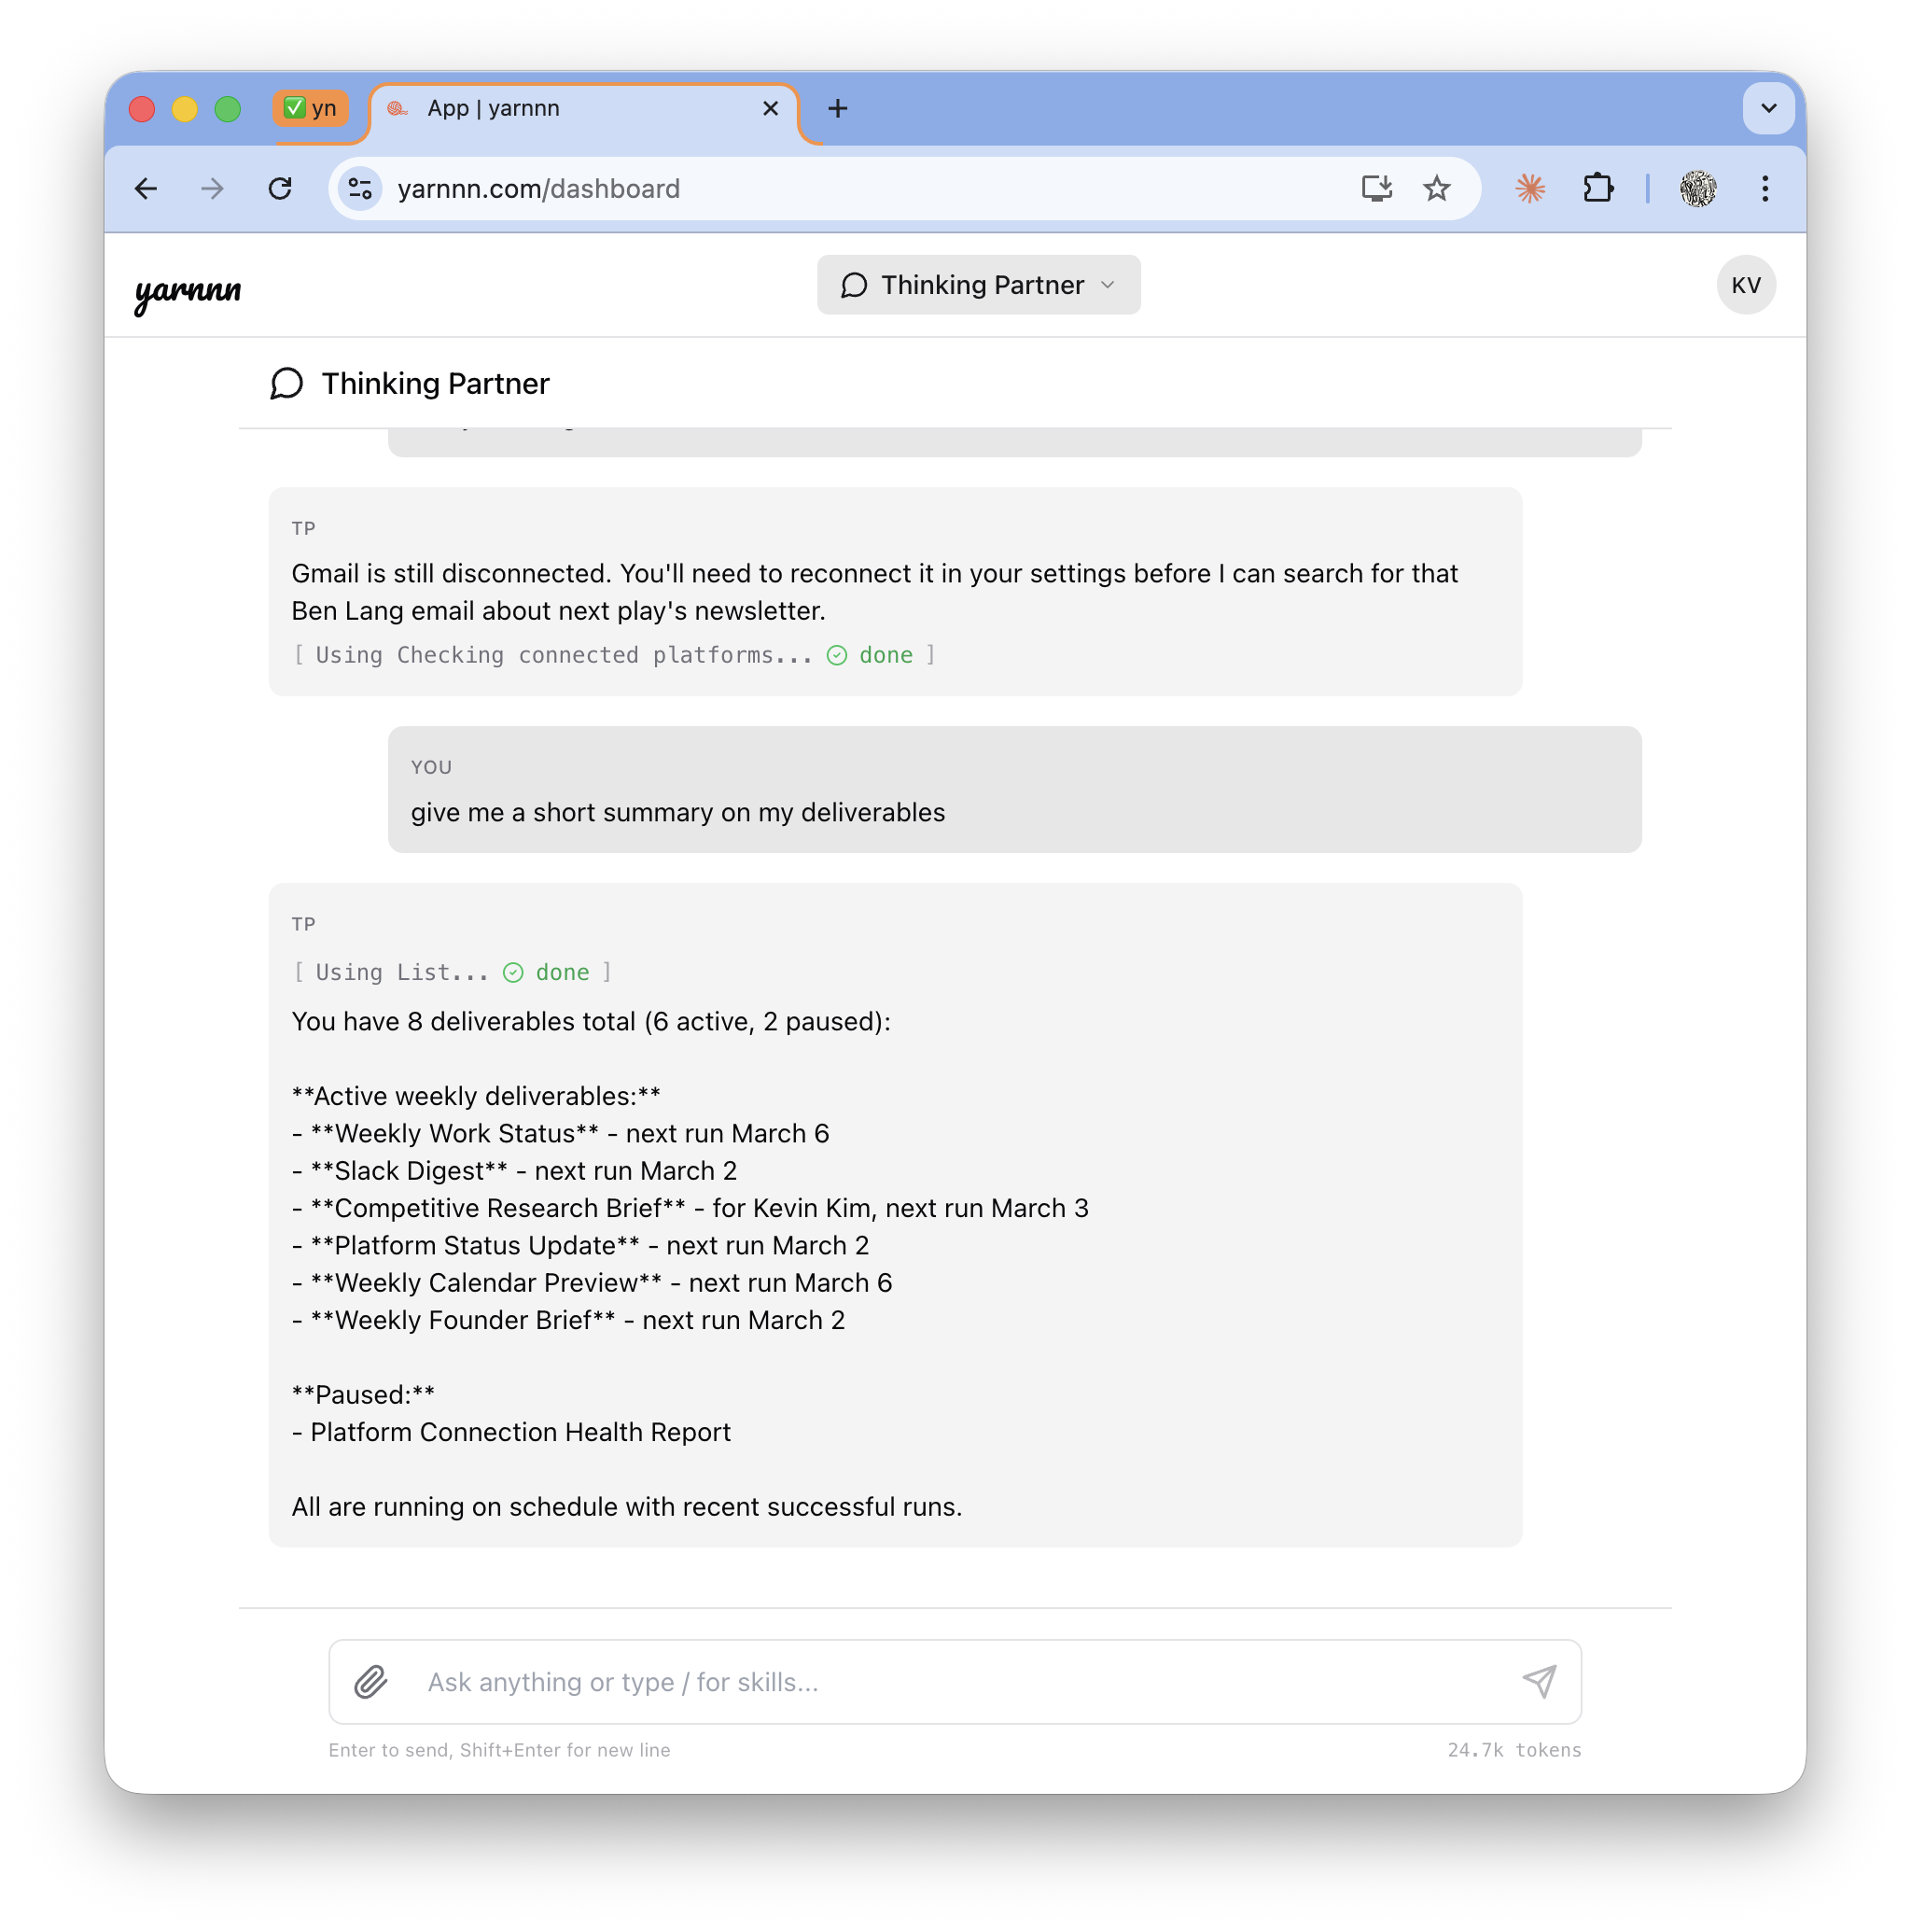
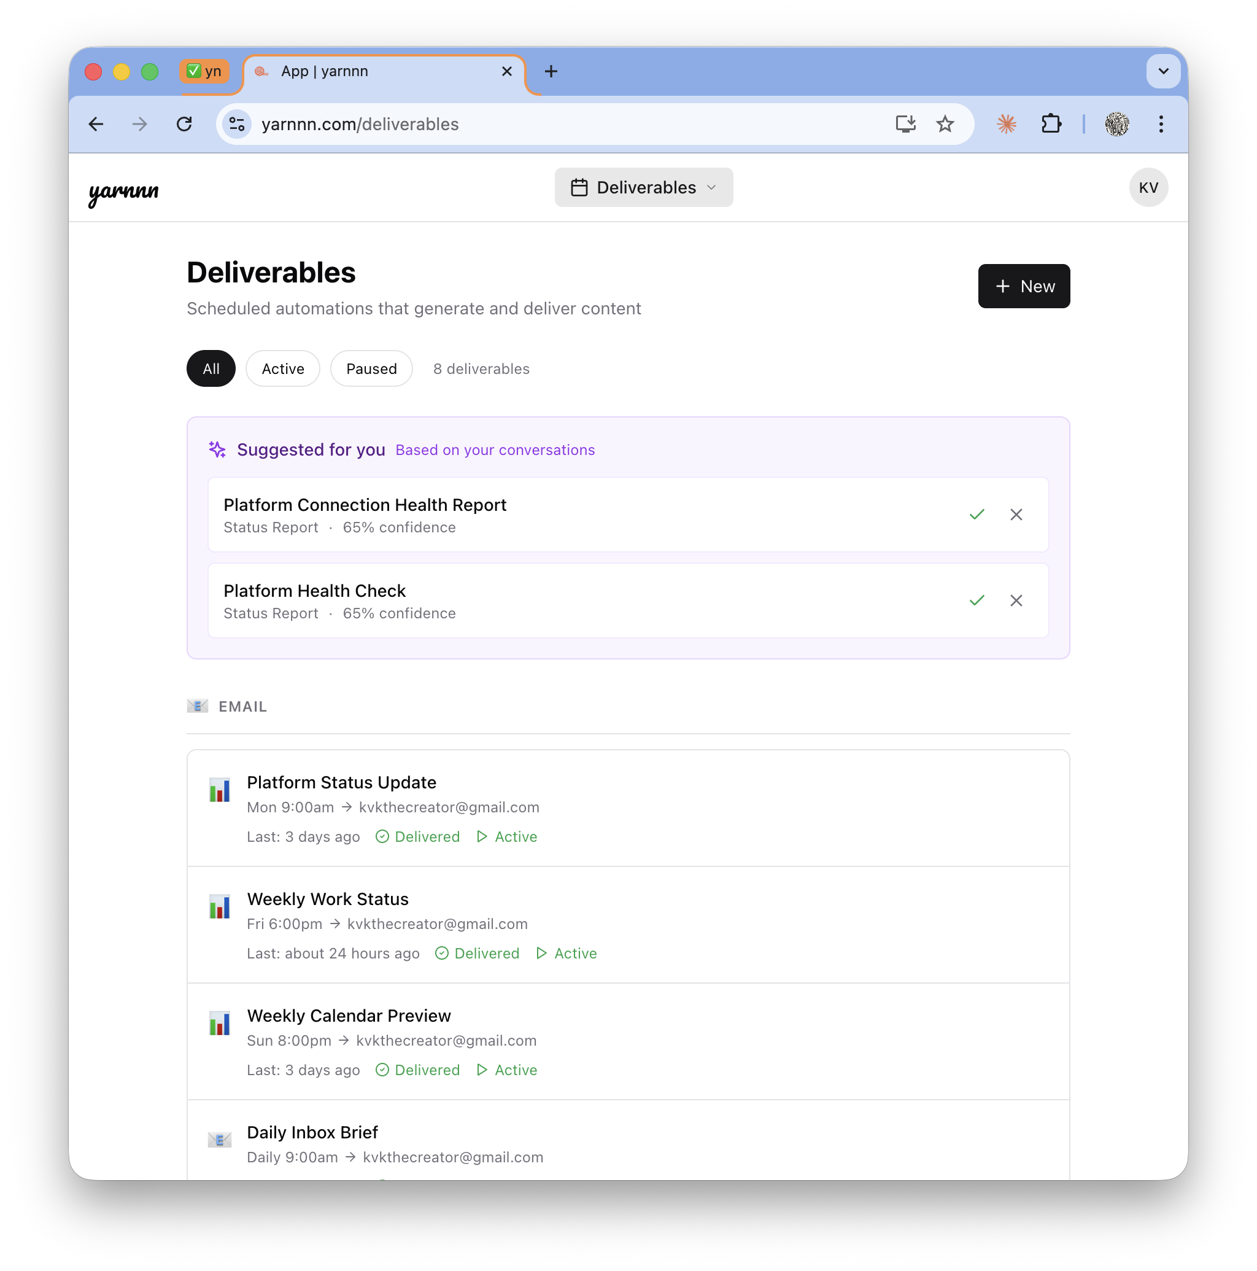
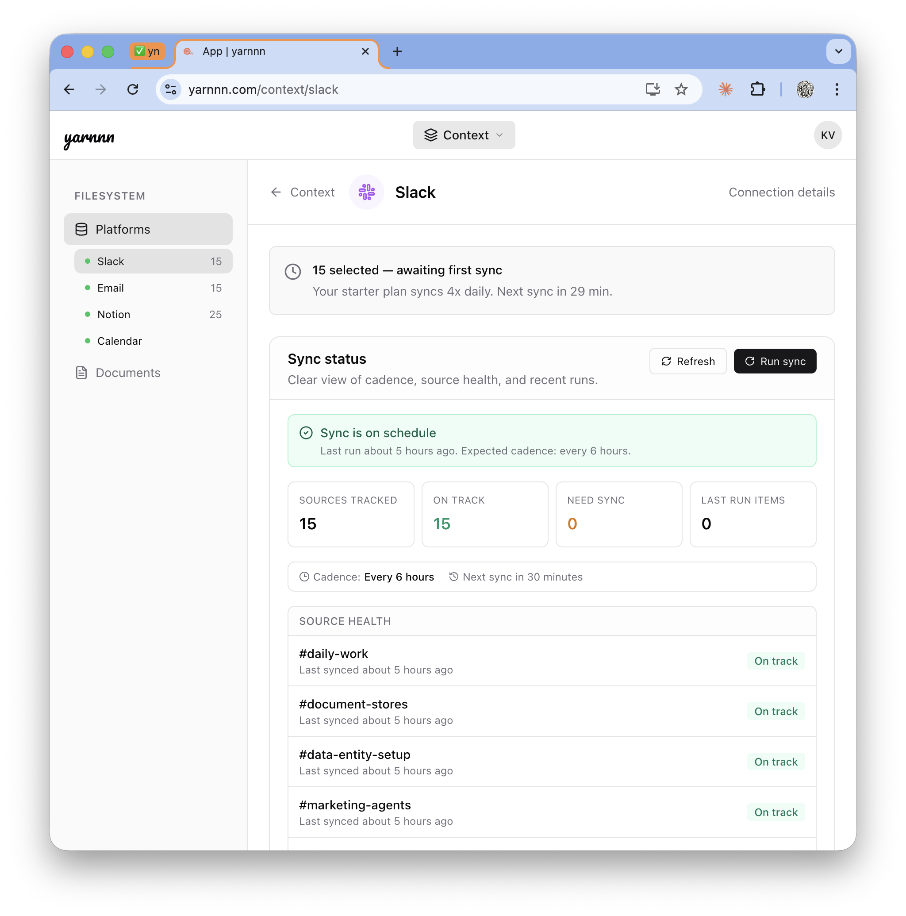
Product: Meet Your AI Employees
Pre-built workforce. Ready on day 1.
T+0s
T+30s
Days
Weeks
Dump, Connect
Team Ready
Accumulate
Compound
Describe your work. Your AI employees are pre-built and ready.
Tasks assigned to the right specialist. Context loading begins.
Every sync deepens knowledge. Every edit refines quality. Teams coordinate.
PM coordination matures. Cross-phase handoffs refine. Output quality compounds.

Slide 7
How Your Employees Work
The infrastructure behind autonomous employees
Five systems that work together. Each one compounds with tenure.
Platforms
+ MCP
Context
Domains
Workspace
Filesystem
Agent
Workforce
Output
Gateway
Slack
Notion · GitHub
Workspace filesystem
Accumulated intelligence
AGENT.md + TASK.md
Inference + memory
10-agent roster
Task pipeline + compose
HTML compose
PDF · PPTX · XLSX
Why tools can't replicate this:
AI Tools (OpenClaw, Cowork, Claude Code)
Agent Memory Startups (Mem.ai, Granola)
Workspace AI (Notion AI, Gemini)
Session-scoped. User must be present. Context resets between runs. No autonomous execution.
Memory without execution. Recall facts but don’t produce autonomous work products.
Single-platform. No cross-platform synthesis. No cross-LLM continuity.

Slide 8
Product
What your employees deliver.
13 job descriptions across 5 departments. Each is a concrete deliverable with a team of AI employees behind it.
Category
Deliverable
Pipeline (agents)
Default cadence
INTELLIGENCE
Competitive Intel Brief
Research → Content
Weekly
Market Research Report
Research → Content
Monthly
Industry Signal Monitor
Marketing → Research
Weekly
OPERATIONS
Meeting Prep Brief
CRM → Research
On-demand
Stakeholder Update
Research → Content
Monthly
Project Status Report
Slack → CRM → Content
Weekly
PLATFORM
Slack Recap
Slack Bot
Daily
Notion Sync Report
Notion Bot
Weekly
CONTENT
Content Brief / Blog Draft
Research → Content
On-demand
Launch Material
Marketing → Content
On-demand
TRACKING
GTM Tracker
Marketing → Content
Weekly
You describe the work. Your employees figure out the team, the handoffs, and the schedule. Deterministic cost, no ad-hoc prompting.

Slide 9
Product
Your team. Eight specialists, each with a role.
Persistent identities. Individual memory. Learned preferences. Team collaboration.
Briefer
Monitor
Researcher
Analyst
Recurring digests from platform activity. Your daily pulse on what happened.
Watches for changes and patterns. Alerts on what matters, ignores what doesn't.
Deep dives with web search. Finds context beyond your connected platforms.
Cross-references sources. Surfaces patterns humans miss across platforms.
Drafter
Writer
Planner
Scout
Produces first drafts from briefs. Turns PM instructions into starting points.
Polished final output. Blog posts, reports, memos that ship as-is.
Roadmaps, strategies, structured plans. Turns goals into actionable sequences.
Tracks competitors and market signals. Watches the outside while you work inside.
Project Manager Agent
Coordinates the team, gates quality, steers contributors. Your AI chief of staff.
One per project.

Slide 10
Product
How Employees Onboard and Grow
Like real employees — they learn your business, then produce. And they get better every week.
Context
Inference
Task Type Selection
Pipeline Execution
Autonomous Delivery
Connect Slack, Notion, GitHub. Context domains accumulate over time.
▶
System reads your work. Extracts identity, brand, scopes from docs + chat.
▶
Pick deliverables from the catalog. Each has a pre-built pipeline.
▶
Task pipeline runs on schedule. Compose substrate assembles structured output.
▶
Output compounds weekly. Feedback refines agents. Quality improves with use.
What makes this an employee, not a tool:
Job descriptions, not ad-hoc prompts
Transparent, editable work product
Tenure creates irreplaceable value
Every task has a defined execution plan. Employees run on schedule, metered transparently. No prompting required.
TASK.md + AGENT.md define everything. No hidden state. You can read and edit the same files your employees use.
Tools reset every session. Employees accumulate expertise. Every run deepens knowledge. 90 days of tenure is irreplaceable.

Slide 11
Solution: Moat
Employee Tenure Is the Moat. Switching Costs Follow.
Tools reset. Employees accumulate. Every run deepens expertise. Every edit teaches preferences. 90 days of tenure is irreplaceable.
Three moat mechanics:
Describe
1
Accumulation: Every execution cycle deepens cross-platform understanding. AI employees don’t start from zero — they compound.
Compounding
Team
Intelligence
2
Cross-LLM Hub: Cross-LLM continuity via MCP. Every LLM the user connects becomes a client of accumulated context. Network effect compounds.
Supervise
Accumulate
3
Irreversibility: 90 days of accumulated employee intelligence — domain knowledge, learned preferences, feedback history — can’t be replicated by downloading a new tool
Coordinate

Slide 12
Positioning • Market •
Competitive Landscape

Slide 13
Positioning
Tools vs. Employees. Two structurally different categories.
The local-first wave proves demand. yarnnn is where tool users graduate when they need work to run without them.
Autonomy
 | yarnnn | AI Tools (OpenClaw, Claude Code, Cowork) ChatGPT + Memory /Claude | Memory Startups (Mem.ai, Granola) Mem.ai, Genspark | Workspace AI (Notion, Gemini) Notion, Slack
Persistent agent identity | ✓ | ✘ | ✘ | ✘
Autonomous scheduled execution | ✓ Evolving | ✘ | ✘ | Single
Cross-platform accumulation | ✓ | ✘ | ✘ | ✘
Feedback compounds quality | ✓ Scheduled | ✘ | ✓ | ✘
Multi-agent coordination | ✓ Accumulation | Evolving | ✘ | ✘
Cloud-native (runs without user) | ✓ | ✘ | ✘ | ✘
yarnnn
ChatGPT + Memory
Claude Cowork /
Genspark
Knowledge
Accumulation
Existing
Workspace AI (Notion, Gemini)
Agent-based
Startups

Slide 14
Market
Starting with solo consultants. Expanding from there.
Entry wedge: Solo consultants with recurring client obligations
TAM
SAM
Entry SOM
$4.35B
$1.14B
$4.6M
AI productivity tools market (31% CAGR)
~5M solo consultants globally × $228/yr (Pro annual)
20K consultants in first 3 years
Expansion path:
Now
Solo consultants graduating from AI tools
Recurring reports, clear pain, willing to pay
Next
Founders & executives
Investor updates, board prep, strategic briefs
Then
Teams & ops leads
Standups, project reports, cross-team synthesis
Scale
All knowledge workers &#x2014; anyone hiring AI employees instead of operating AI tools
Any professional with recurring work obligations

Slide 15
Pricing Model
Usage-first billing. Balance is the single gate.
Free
Pro
Enterprise
$0
$19
TBD
/mo
/mo
/mo
· $3 signup balance included
· $20/mo balance auto-refills
· Everything in Pro
· All platforms + tasks unlocked
· All platforms + tasks unlocked
· Team workspaces
· ~40 chat turns + 10 task runs
· Meaningful autonomous workload
· Priority support
· Token spend metered in USD
· $19/mo or $180/yr
· Custom integrations
· Top up anytime: $10 / $25 / $50
· Best value for regular users
· Agent-to-agent protocol
2x markup on Anthropic API rates = ~50% gross margin. No operational limits. Balance is the single gate.
Every LLM call metered transparently in USD. Users see exactly what they spend. You pay employees, not for features.

Slide 16
Product Roadmap
AI Workforce + MCP Hub (shipped) → Platform Expansion → Agent Protocol
Each phase deepens the value chain. Shipped work compounds into the next layer of capability.
SHIPPED ✓
NEXT 6-12mo.
VISION +12mo.
Coordinated Agent
Teams
Platform
Expansion
Agent-to-Agent
Protocol
Work-first onboarding + project scaffolding
►
MCP Context Hub: cross-LLM continuity (shipped)
►
Agent-to-agent protocol. Agents across systems coordinate
PM phase dispatch + quality gating
Compose substrate: section-scoped revision
Team workspaces: multi-user shared context
8 agent types (three-registry)
Usage-first billing: token spend metering (shipped)
Platform play: own the work context graph
Output gateway: HTML compose, PDF, PPTX, XLSX
Deeper platform coverage: 365, Google Drive
Feedback substrate: edit distillation + self-reflection
Workspace filesystem + cross-agent collaboration
170+ Architecture Decision Records

Slide 17
(Pre) Seed - The Ask
$500K at $5M post-money valuation.
Use of funds:
Why now:
Positioning:
→ Tech Lead (memory/ML)
→ OpenClaw: 307K stars / 60 days
→ Tools are everywhere. Employees are greenfield.
→ GTM Lead (creator community)
→ No one owns the employee layer
→ AI employees, not AI tools
→ 12 months runway
→ Architecture built, need team
Priority 0: Team-Building
Betting on an agent-first future:
Differentiation:
→ ML engineer for memory extraction
→ Demand proven (307K stars). Employee gap open.
→ Persistent employees, not session-scoped tools
→ Community builder for creator GTM
→ Tools create demand. Employees capture it.
→ Cloud-native by structural necessity
→ Seed funds → team of 3
→ 170+ ADRs = architectural rigor

Slide 18
yarnnn.com · Kevin Kim · seulkim88@gmail.com

Slide 19
Appendix
Kevin (Seul Ki) Kim
Founder & CEO, KVK Labs (yarnnn)
https://www.linkedin.com/in/kimseulki0727/
B.S. Industrial and Systems Engineering, Virginia Tech
+10 years designing CRM and GTM systems in FMCG.
CMO, CPO positions in Korea based startups, Ran e-commerce fashion brand for 5 years,
Full-stack application for yarnnn, (Next.js + FastAPI + Supabase), two platform integrations,
autonomous AI employee architecture with task execution pipeline, documented across 170+
Architecture Decision Records.
Targeting US market; execute GTM and team-building as priority next step.
yarnnn.com · Kevin Kim · kvkthecreator@gmail.com

Slide 20
Appendix: Value Realization Chain
What the User Experiences: Describe to Compound
Time | What happens | What the user sees
T+0s | User describes work, tasks scaffold | "I've set up 3 projects for your client work"
T+30s | Platforms connect, sources mapped to tasks | Dashboard: "Slack connected — channels mapped"
T+90s | Scheduler dispatches first task runs | First deliverables appear per project
Day 2-7 | Daily pulse cycles, agents accumulate | Deliverables arrive, improving each run
Week 2 | Cross-LLM context hub via MCP | Agent collaboration visible in output
Month 1 | Multiple agents running, feedback refining | Agents noticeably tailored to preferences
Month 3 | System identifies cross-task opportunities | System understands work deeply
Describe → Scaffold → Connect → First Value → Accumulate → Coordinate → Compound ↻

Slide 21
Appendix: Architecture Depth
What a Well-Funded Team Can't Shortcut
"Claude Code Online" — Output Gateway
Multi-Agent Task Pipeline
Same capabilities model as Claude Code (SKILL.md + local tools + filesystem), but persistent, autonomous, and cloud-native — the structural requirements tools can’t satisfy. Two-filesystem architecture: capability filesystem (skills on Docker) + content filesystem (workspace per agent). Adding a new output format = adding a skill folder.
Tasks define execution. Agents dispatched per TASK.md. Cross-agent context injection.
Feedback-to-Intelligence Loop
Charter-Driven Deterministic Execution
Three unified feedback rails: user edits distilled to persistent preferences, agent self-reflection after every run, PM reads contributor trajectories. Employees improve with tenure is structural, not aspirational.
Task charter files (TASK.md + DELIVERABLE.md + AGENT.md) define execution deterministically. Cadence enforcement prevents runaway loops. ~$0.06–$0.16 per task run at steady state. Predictable cost model.
Why this compounds into defensibility:
The PM coordination can't work without the feedback substrate. The feedback substrate can't work without the workspace filesystem. The workspace filesystem can't work without the perception pipeline populating it. A team starting today would need to discover these interdependencies through the same 170+ decisions — or build a simpler system that can't compound.

